Slide 1







Our Github Rep. o:
DEPI - 236
GROUP 2
ORANGE HRM
Software Testing
Under Supervision of: Eng. Ahmed Halim ♥
Presented By: Group 2

Slide 2


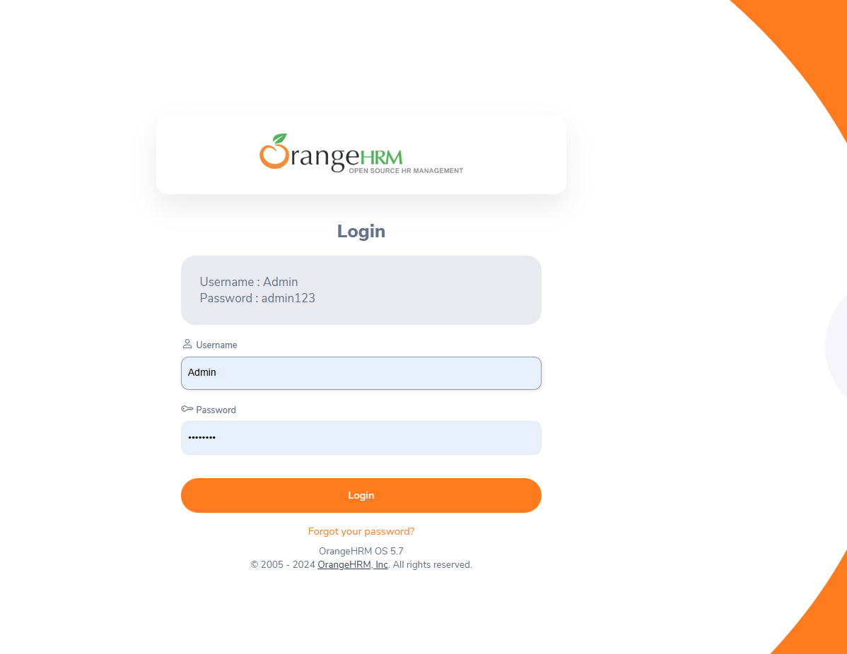
Team Members
Abdullah Wahid
Mohamed Abdelrehem
Sara Ramadan
Eman Mahmoud
Nourhan Mohamed

Slide 3


Manual Testing
Our working strategy
01
02
03
Detailed bug reports linked to the related user stories and test cases, including evidence such as screenshots or videos.
Test cases for as many features as possible.
Each test case is linked to its user story on Jira.

Slide 4

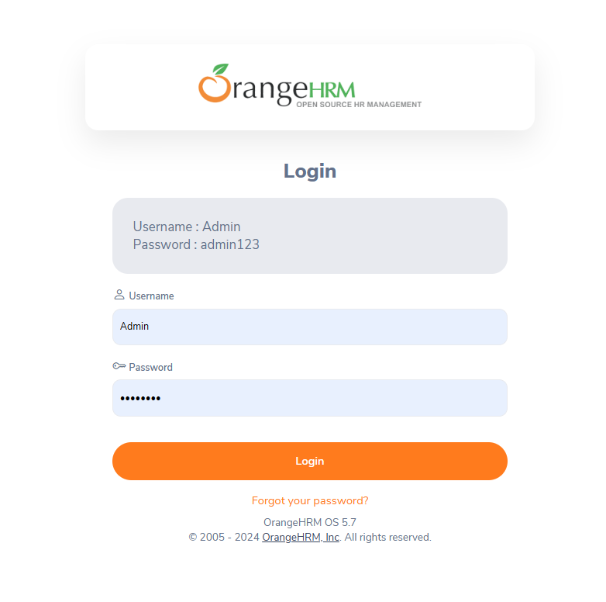

ORANGE HRM
HR Mangment System
Login
Abdullah Wahid
I thoroughly tested the login page, covering all key features:
Username Textbox: Validated input formats and error handling.
Password Textbox: Tested password validation, including length and complexity requirements.
Forgot Password: Verified the full reset process, ensuring both successful and unsuccessful scenarios were handled properly.
Manual
Number of Testcases: 8
Number of Bugs: 2

Slide 5
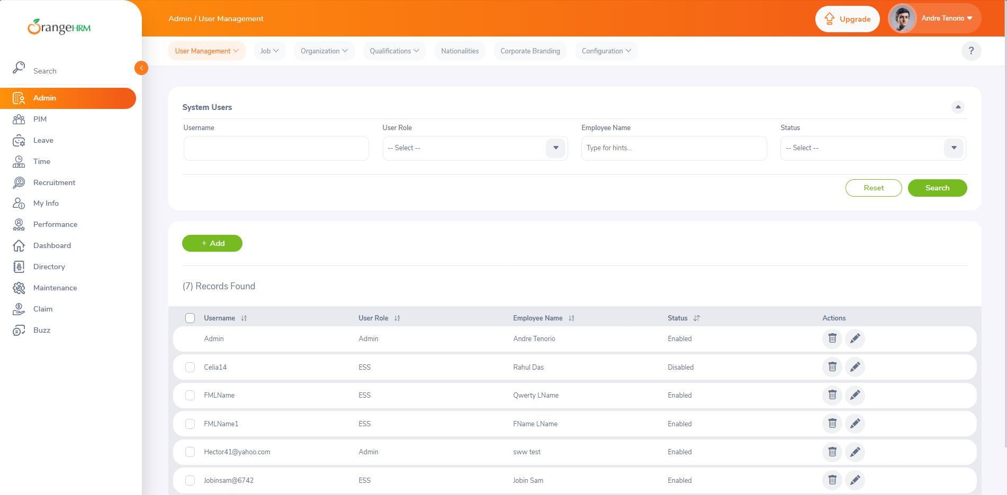
ORANGE HRM
HR Mangment System
Admin
Abdullah Wahid
I conducted thorough testing covering:
User Management: Verified search, sorting, adding, editing, and deleting users.
Job Management: Tested job titles, categories, and specifications.
Organization: Ensured proper management of organizational units.
Qualifications: Validated skills, education, and licenses linked to employee records.
Nationalities: Checked nationality additions and consistency in dropdowns.
Corporate Branding: Verified smooth application of logo and design changes.
Configuration: Ensured system preferences functioned correctly.
Manual
Number of Testcases: 38
Number of Bugs: 3

Slide 6
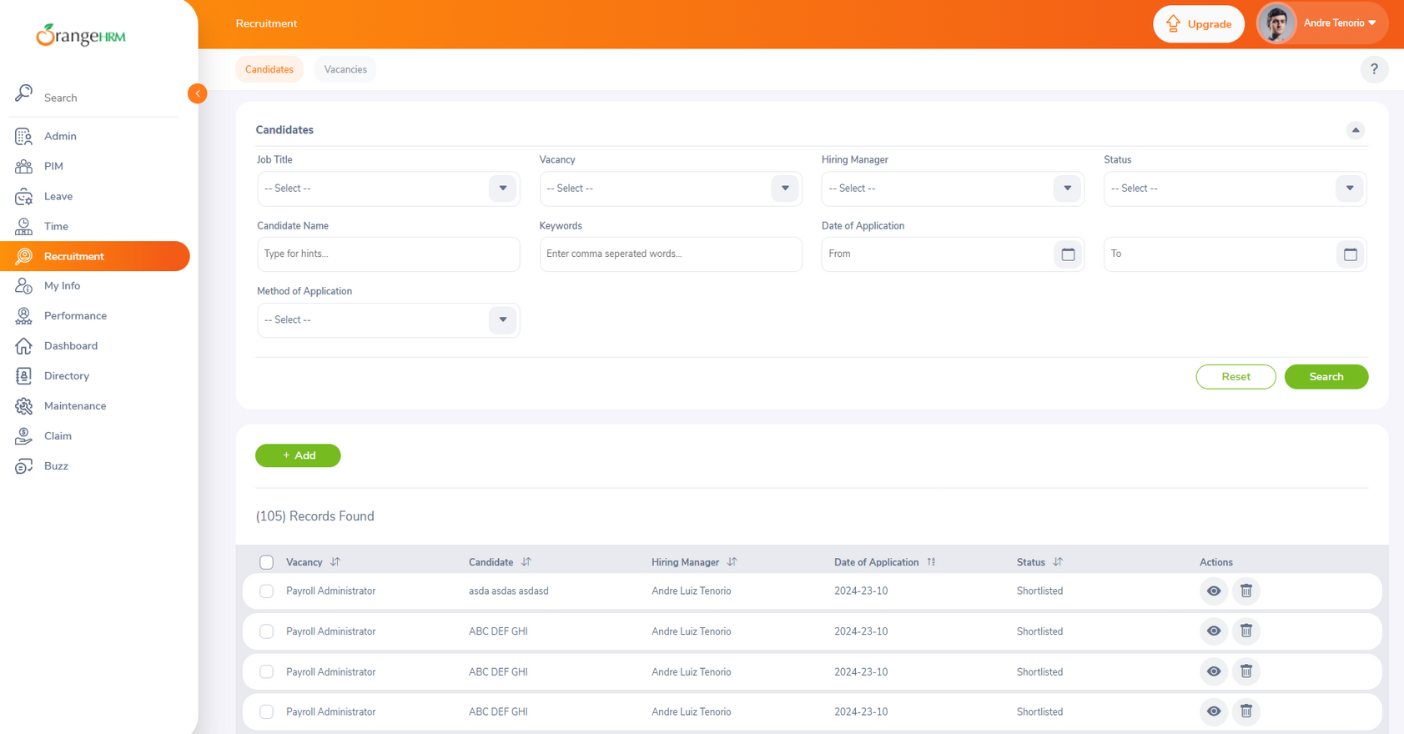
ORANGE HRM
HR Mangment System
Recruitment
Mohamed Abdelrehem
I thoroughly tested the Recruitment page, covering:
Candidates: Verified candidate search, tracking, and application management.
Vacancies: Tested job posting, vacancy details, and hiring workflow. This ensured reliable functionality throughout the Recruitment module.
Manual
Number of Testcases: 15

Slide 7
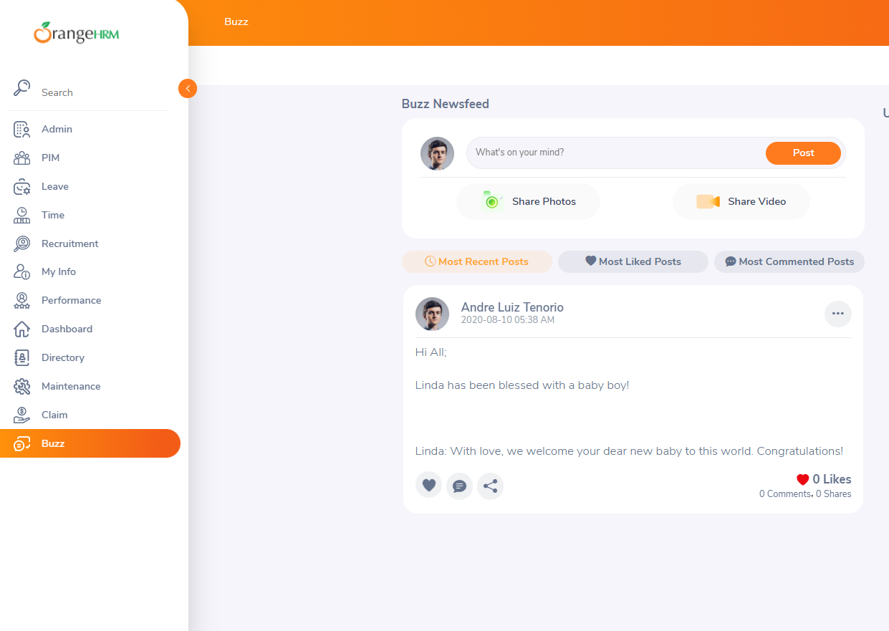
ORANGE HRM
HR Mangment System
Buzz
Mohamed Abdelrehem
I thoroughly tested the Buzz page, covering:
Buzz Newsfeed: Verified post creation, sharing media, commenting, Editing, and feed updates.
Manual
Number of Testcases: ??

Slide 8
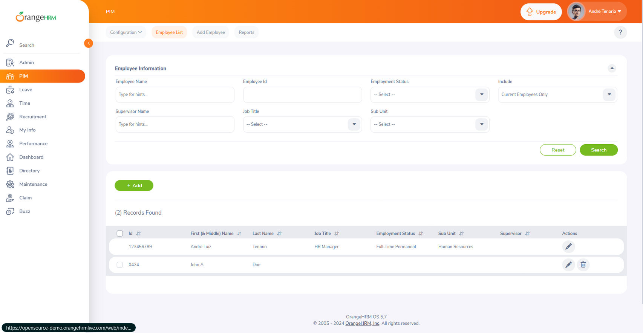
ORANGE HRM
HR Mangment System
PIM
Sara Ramadan
I thoroughly tested the PIM page, covering:
Configuration: Verified functionality for configuration settings, optional fields, custom fields, data import, reporting methods, and termination reasons.
Employee List: Tested search, sorting, and filtering of employee records.
Add Employee: Ensured accurate data entry, validation, and proper saving of employee details.
Reports: Validated report generation, filtering, and accuracy of displayed data
Manual
Number of Testcases: 57
Number of Bugs: 3
(there is more bugs in data validation fields, but not present in the document)

Slide 9
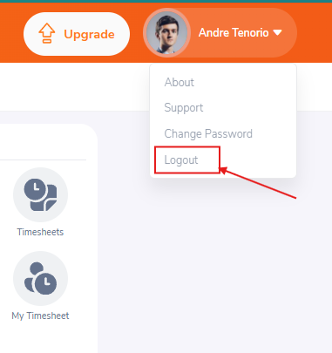
ORANGE HRM
HR Mangment System
Logout
Sara Ramadan
I thoroughly tested the Logout page, covering:
Verify that the 'Logout' button is accessible from any page within the user profile screen.
Verify that the Functionality 'Logout' button
Manual
Number of Testcases: 2

Slide 10
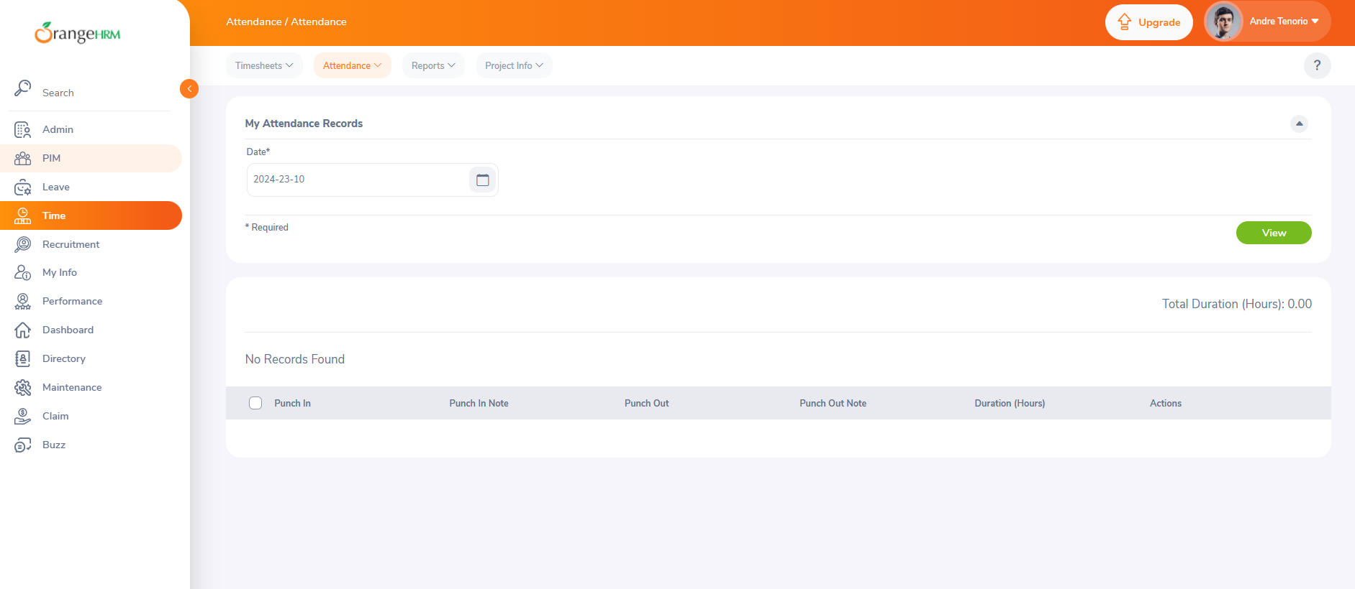
ORANGE HRM
HR Mangment System
Attendance
Eman Mahmoud
I thoroughly tested the Attendance page, covering:
My Records: Verified accurate tracking and display of individual attendance records.
Punch In/Out: Tested functionality for clocking in and out, ensuring correct time logging and error handling.
Employee Records: Validated search, sorting, and filtering of attendance data for all employees.
Configuration: Ensured proper setup and management of attendance settings.
Manual
Number of Testcases: 8

Slide 11
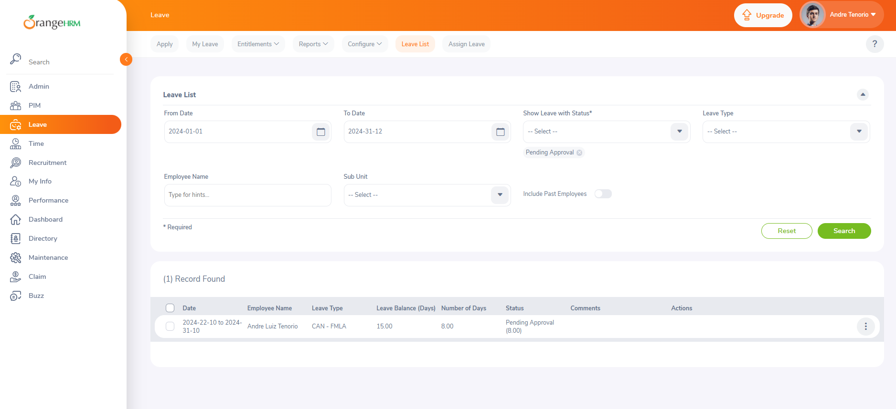
ORANGE HRM
HR Mangment System
Leave
Eman Mahmoud
I thoroughly tested the Leave page, covering:
Apply: Verified leave application process and validation.
My Leave: Tested personal leave record management.
Entitlements: Validated all entitlement functionalities.
Reports: Verified leave entitlement and usage reporting.
Configure: Tested leave settings and holiday management.
Leave List: Validated employee leave request handling.
Assign Leave: Ensured proper leave assignment functionality. This ensured reliable functionality throughout the Leave module.
Manual
Number of Testcases: 17

Slide 12


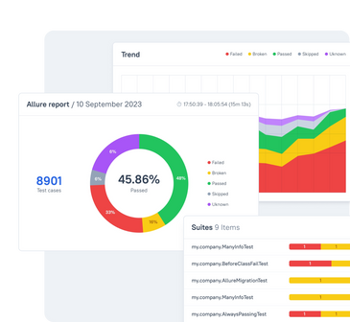
Test Automation
Our working strategy
01
02
03
Framework built using Page Object Model (POM).
Project managed using Maven.
Test scripts created with Selenium 4, Java, and TestNG.
03
Using Allure reports with screenshots on pass and failure

Slide 13


Test Automation Video
01
Automation Video Link
03
https://drive.google.com/file/d/1SFlU02fUIQYWViSHjWv_tWHvxfh4PyNg/view?usp=sharing

Slide 14

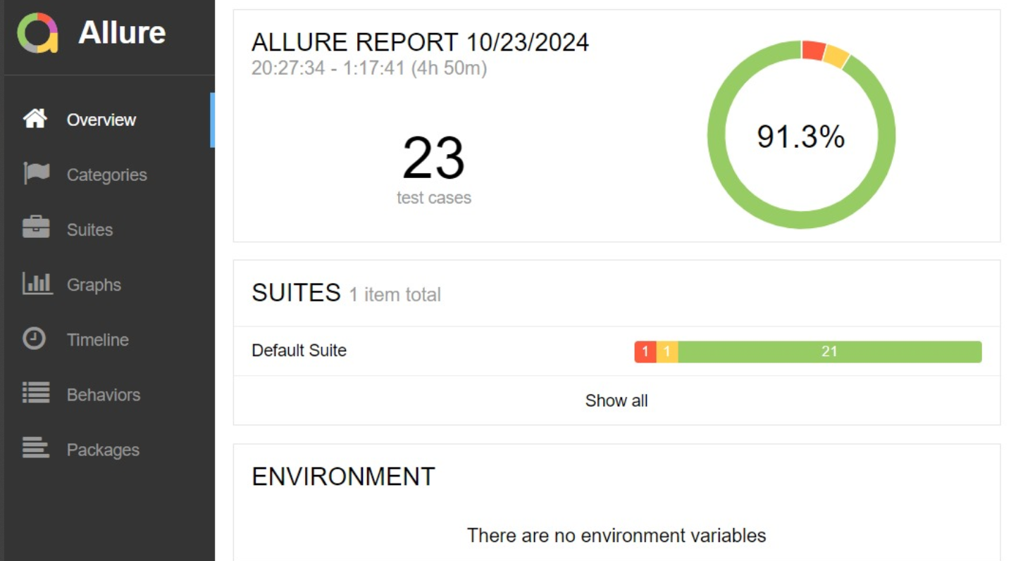
our result in Allure Report
KPI # 1

Slide 15

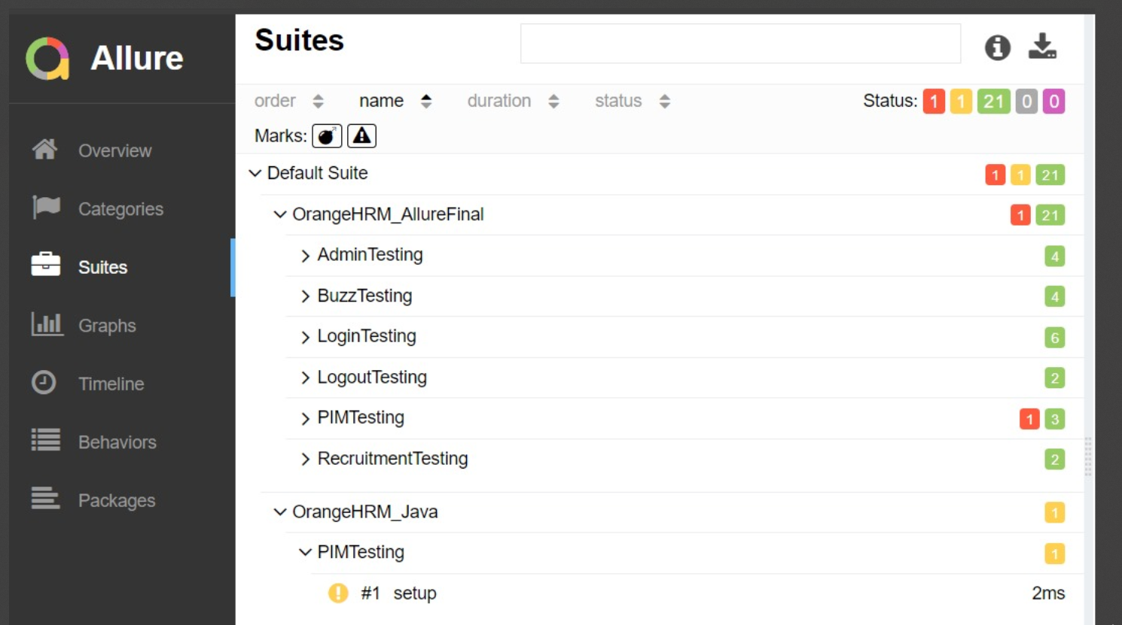
our result in Allure Report
test case isTerminationReasonPresent
is failed as the reason found is equal 0 as Termination reason 'Deceased' not found in records! so Expected :true
Actual :false

Slide 16




ANY QUESTIONS?
Calle Cualquiera 123, Cualquier Lugar

